Slide 1
Introduction to Stoichiometry
November 2017

Slide 2
Consider the following recipe for making pancakes:

Slide 3
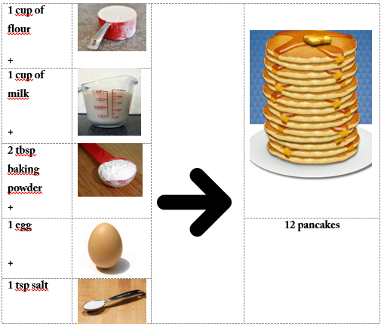

Slide 4
We could write this recipe like a chemical reaction:
1Flour + 1Milk + 2Baking soda + 1Egg + 1Salt → 12 Pancakes
How would the recipe change if you wanted to make:
24 pancakes?
6 pancakes
What is important is that the number of each ingredient remains in the same ratio!

Slide 5
1Flour + 1Milk + 2Baking soda + 1Egg + 1Salt → 12 Pancakes
How do the amounts of flour and milk compare?
If 3 cups of flour are added, how much milk will need to be added?
If 1 cup of flour is added, how many tbsp. of baking soda need to be added?
If 6 cups of milk are added, how many eggs need to be added?
If 4 eggs are added how many pancakes could be made? (Assuming all the other ingredients are also increased accordingly.)

Slide 6
Ratios are important in chemical reactions as well.
How many of each reactant and product must stay in the same ratio as it is in the balanced equation. Remember: In chemistry how many is the unit mole.

Slide 7
So where did this strange word stoichiometry come from? It was introduced into chemistry in 1807 and is based on the Greek word for element (stoich) and measurement (metry).
Stoichiometry is the quantitative (how much in moles) relationship between reactants and products in a chemical reaction.

Slide 8
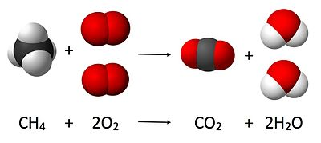
Consider the reaction below:

Slide 9
1CH₄ + 2O₂ → 1CO₂ + 2H₂O
For every 1 molecule of CH₄ _____ molecules of O₂ are needed.
OR
For every 1 mole of CH₄ ____ moles of O₂ are needed.
How many moles of water are produced if:
3 moles of CH₄ react?
2.5 moles of CH₄ react?
4 moles of O₂ react?

Slide 10
2H₂ + O₂ → 2H₂O
How many moles of water are produced if:
1.5 moles of H₂ react?
1.2 moles of O₂ react?

Slide 11
3H₂ + N₂ → 2NH₃
How many moles of H₂ are needed:
1 moles of N₂ react?
4 moles of N₂ react?
0.22 moles of N₂ react?
How many moles of N₂ are needed if:
3 moles of H₂ are react?
9 moles of H₂ react?
2.4 moles of H₂ react?

Slide 12
3H₂ + N₂ → 2NH₃
How many moles of NH₃ are formed if:
1 moles of N₂ react?
2.5 moles of N₂ react?
0.134 moles of N₂ react?

Slide 13
